Slide 1
Sinusoidal Steady-State Power Calculations
Chapter 10

Slide 2
Week 10 Chapter 10 (AC Power)
Instantaneous Power
Average and Reactive Power
The rms Value and Power Calculations
Complex Power
Power Calculations
Maximum Power Transfer

Slide 3
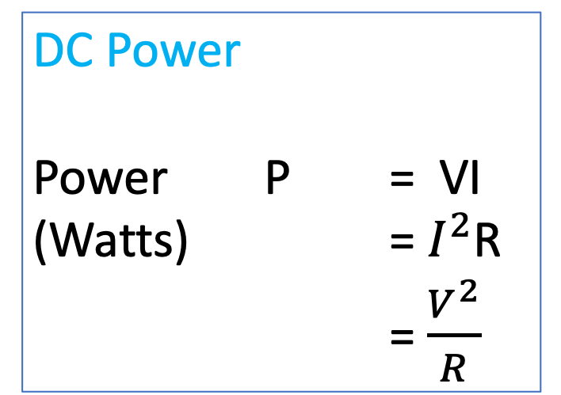
10.0 DC Power
DC Power
Power P = VI
(Watts) = $I^{2}$R
= $\frac{V^{2}}{R}$

Slide 4
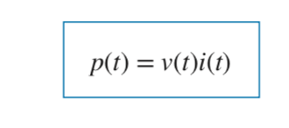

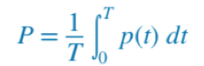
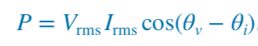
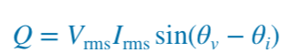

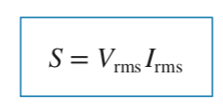
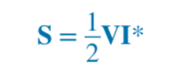

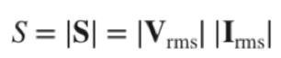
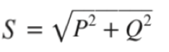
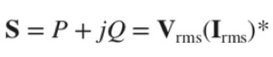
10.0 The Many Definitions of AC Power
The average power, in watts, is the average of the instantaneous power over one period. It is also equal to real power or true power.
Reactive power
(VARs)

Slide 5
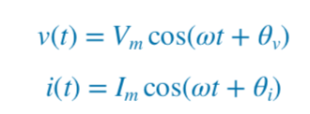
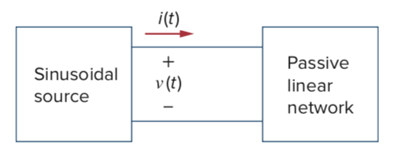
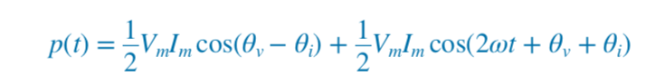
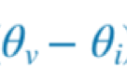
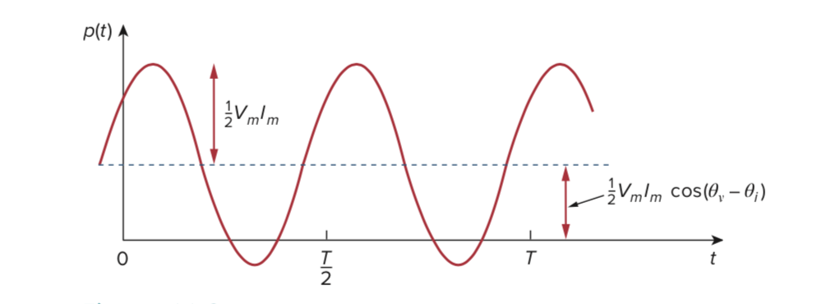
10.1 Instantaneous Power
Things to note about p(t):
The frequency is twice that of v or i
P can be negative for some intervals

Slide 6
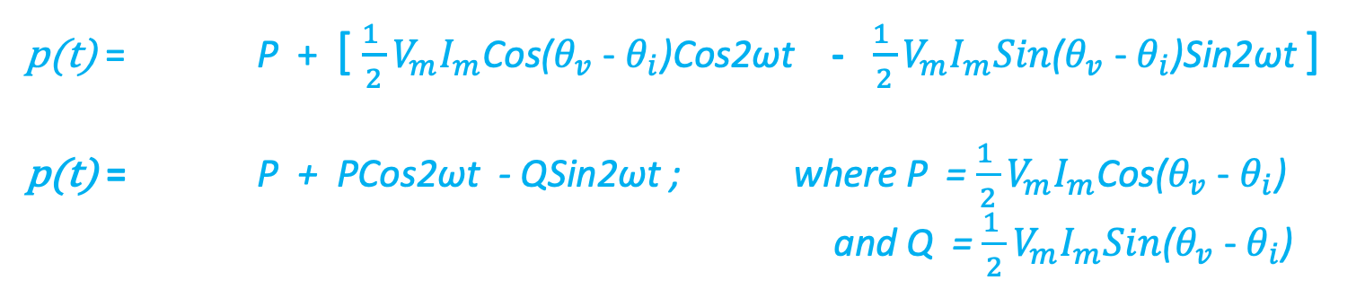
10.1 Instantaneous Power
p(t) = P + [ $\frac{1 }{2}V_{m}I_{m}$Cos($θ_{v}$ - $θ_{i}$)Cos2ωt - $\frac{1 }{2}V_{m}I_{m}Sin$($θ_{v}$ - $θ_{i}$)Sin2ωt ]
p(t) = P + PCos2ωt - QSin2ωt ; where P = $\frac{1 }{2}V_{m}I_{m}$Cos($θ_{v}$ - $θ_{i}$)
and Q = $\frac{1 }{2}V_{m}I_{m}Sin$($θ_{v}$ - $θ_{i}$)

Slide 7
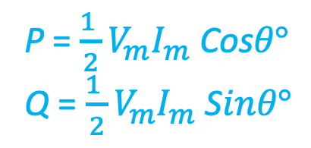
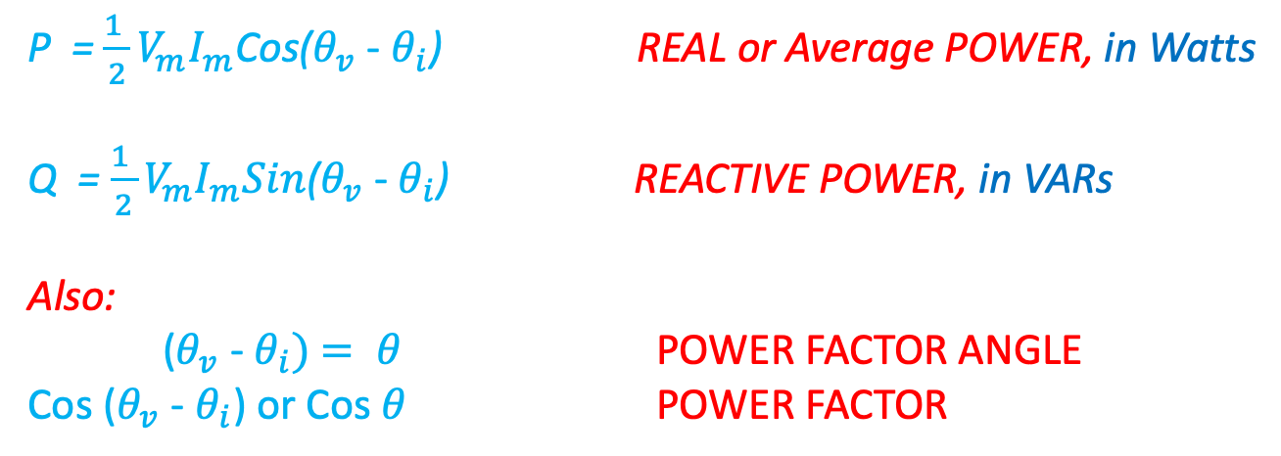
10.1 Instantaneous Power
P = $\frac{1 }{2}V_{m}I_{m}$Cos($θ_{v}$ - $θ_{i}$) REAL or Average POWER, in Watts
Q = $\frac{1 }{2}V_{m}I_{m}Sin$($θ_{v}$ - $θ_{i}$) REACTIVE POWER, in VARs
Also:
($θ_{v}$ - $θ_{i})$ $= θ$ POWER FACTOR ANGLE
Cos ($θ_{v}$ - $θ_{i}$) or Cos $θ$ POWER FACTOR
P = $\frac{1 }{2}V_{m}I_{m}$ Cos$θ°$
Q = $\frac{1 }{2}V_{m}I_{m}$ S$inθ°$

Slide 8
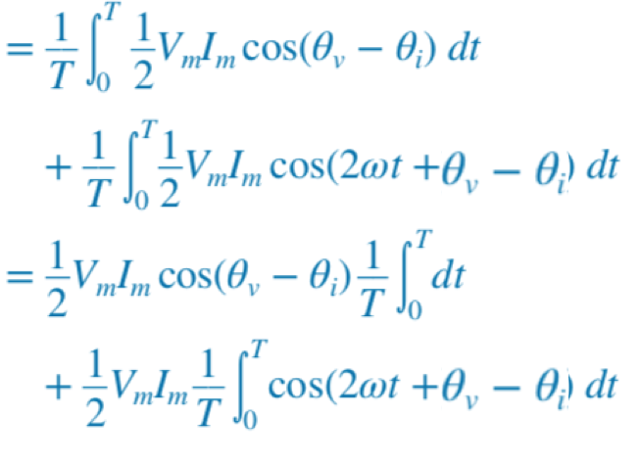
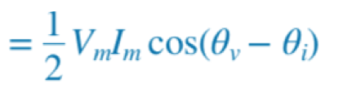
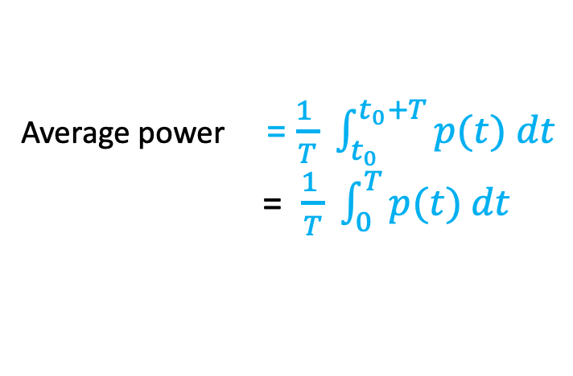
10.2 Average & Reactive Power
Average power = $\frac{1 }{T} \int_{t_{0}}^{t_{0}+T}{p(t) dt}$
= $\frac{1 }{T} \int_{0}^{T}{p(t) dt}$
Which is the same formula as REAL POWER!!
Hence, Average Power is the same as Real Power

Slide 9
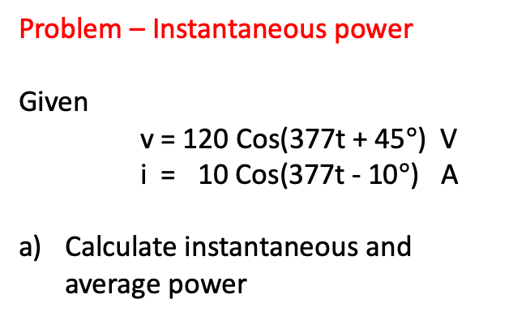
10.2 Average & Reactive Power Problem - Instantaneous power
Problem – Instantaneous power
Given
v = 120 Cos(377t + 45$°$) V
i = 10 Cos(377t - 10$°$) A
Calculate instantaneous and average power

Slide 10
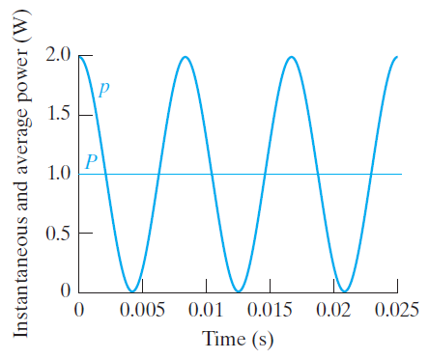
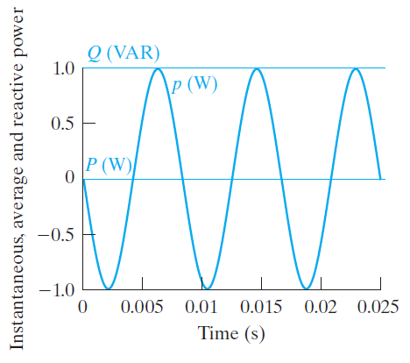
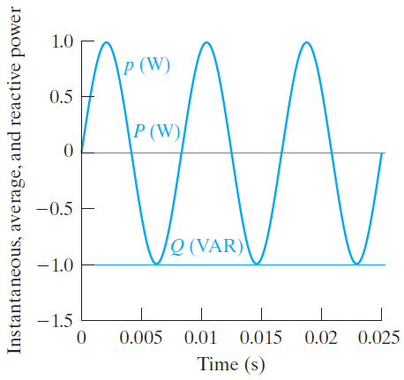
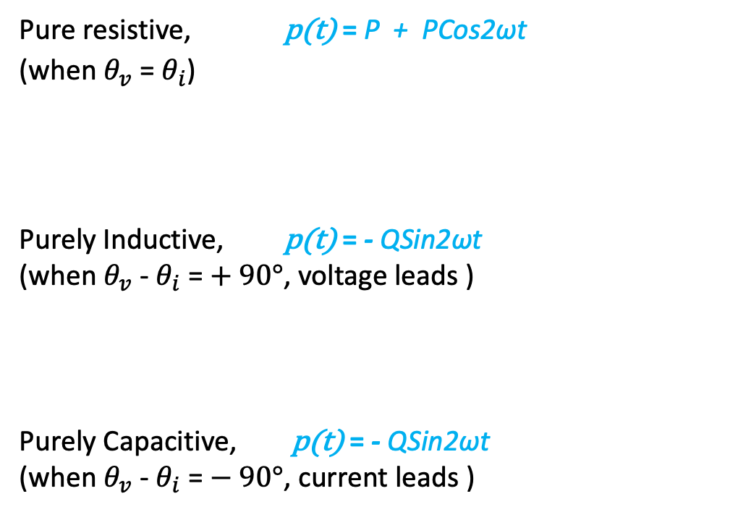
10.2 Average & Reactive Power
Instantaneous power, p(t) = P + PCos2ωt - QSin2ωt
Pure resistive, p(t) = P + PCos2ωt
(when $θ_{v}$ = $θ_{i}$)
Purely Inductive, p(t) = - QSin2ωt
(when $θ_{v}$ - $θ_{i}$= $+ 90°$, voltage leads )
Purely Capacitive, p(t) = - QSin2ωt
(when $θ_{v}$ - $θ_{i}$= $− 90°$, current leads )
+ve VARs for Inductance
-ve VARs for Capacitance

Slide 11
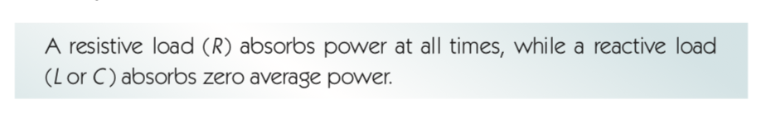

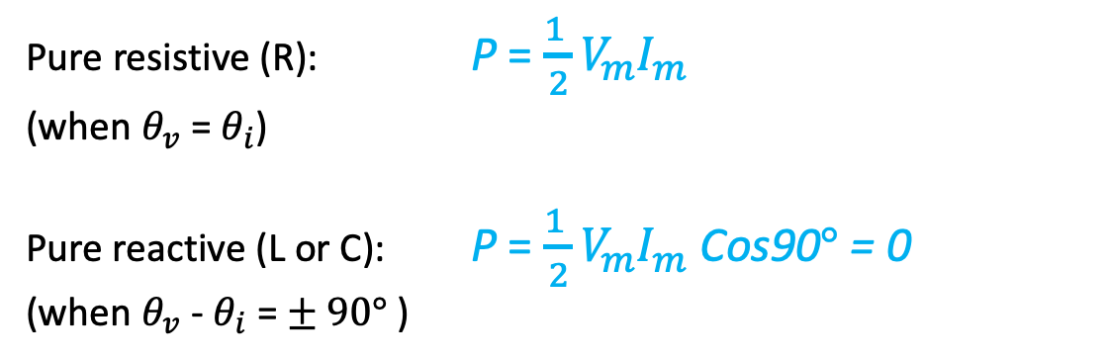
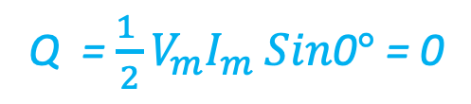
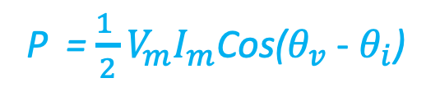
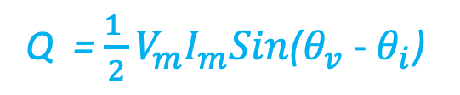
10.2 Average & Reactive Power
Real (Average) power (Watts)
Reactive power (VARs)
P = $\frac{1 }{2}V_{m}I_{m}$Cos($θ_{v}$ - $θ_{i}$)
Q = $\frac{1 }{2}V_{m}I_{m}Sin$($θ_{v}$ - $θ_{i}$)
Pure resistive (R): P = $\frac{1 }{2}V_{m}I_{m}$
(when $θ_{v}$ = $θ_{i}$)
Pure reactive (L or C): P = $\frac{1 }{2}V_{m}I_{m}$ Cos90$°$ = 0
(when $θ_{v}$ - $θ_{i}$= $± 90°$ )
Q = $\frac{1 }{2}V_{m}I_{m} Sin$0$°$ = 0
Q = $± \frac{1 }{2}V_{m}I_{m}$

Slide 12
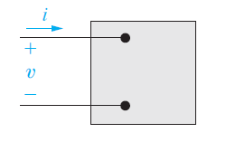
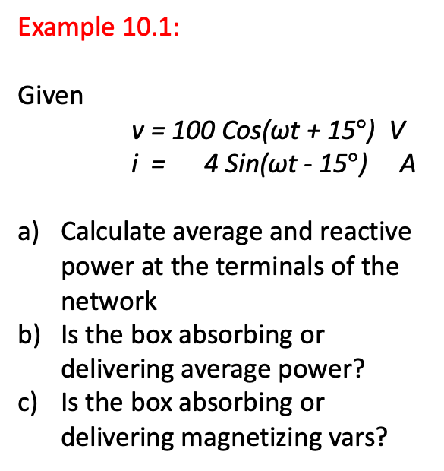
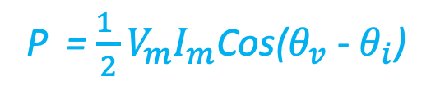
10.2 Average & Reactive Power Example 10.1
Example 10.1:
Given
v = 100 Cos(ωt + 15$°$) V
i = 4 Sin(ωt - 15$°$) A
Calculate average and reactive power at the terminals of the network
Is the box absorbing or delivering average power?
Is the box absorbing or delivering magnetizing vars?
Passive sign convention
is important!
P = $\frac{1 }{2}V_{m}I_{m}$Cos($θ_{v}$ - $θ_{i}$)

Slide 13
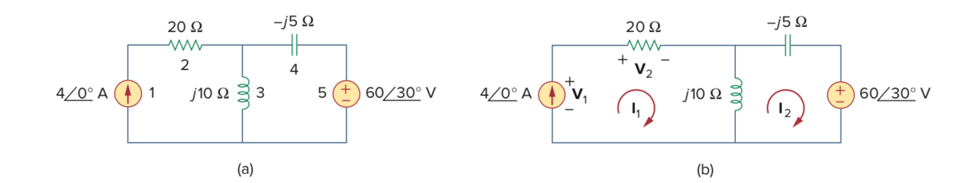
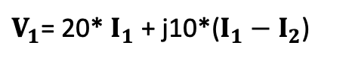
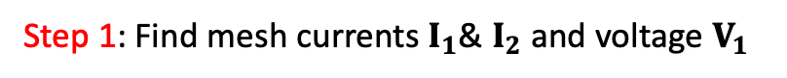
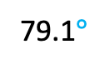
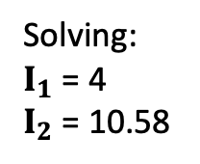

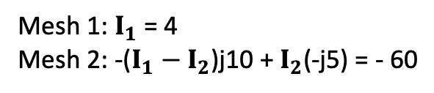
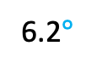
10.2 Average & Reactive Power
Problem: Average power
Find the average (real) power generated by each source, and the average power absorbed by each passive element
Step 1: Find mesh currents $I_{1}$& $I_{2}$ and voltage $V_{1}$
Solving:
$I_{1}$ = 4
$I_{2}$ = 10.58
Mesh 1: $I_{1}$ = 4
Mesh 2: -($I_{1}$ $− I_{2}$)j10 + $I_{2}$(-j5) = - 60
30$°$
79.1$°$
$V_{1}$= 20* $I_{1}$ + j10*($I_{1}$ $− I_{2}$)
= 185
6.2$°$

Slide 14
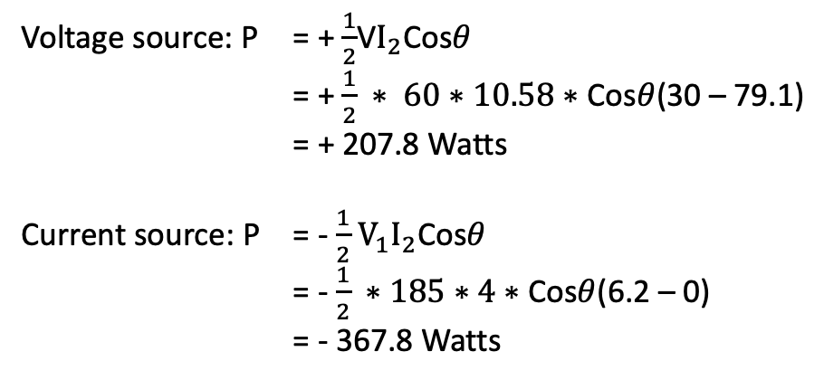
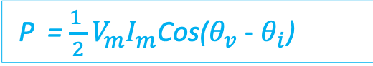
10.2 Average & Reactive Power
P = $\frac{1 }{2}V_{m}I_{m}$Cos($θ_{v}$ - $θ_{i}$)
Step 2: Finding average power in sources
Voltage source: P = + $\frac{1}{2}$V$I_{2}$Cos$θ$
= + $\frac{1}{2} ∗ 60∗10.58∗$ Cos$θ$(30 – 79.1)
= + 207.8 Watts
Current source: P = - $\frac{1}{2}$ $V_{1}I_{2}$Cos$θ$
= - $\frac{1}{2} ∗185∗4∗$Cos$θ$(6.2 – 0)
= - 367.8 Watts

Slide 15
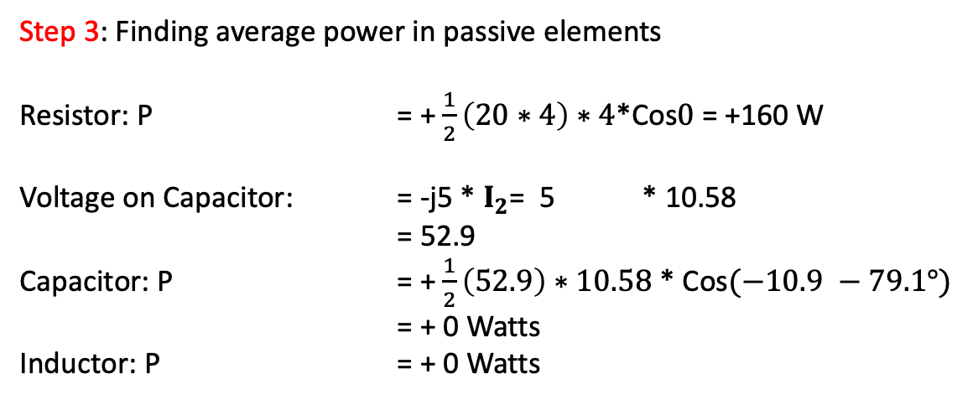
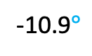

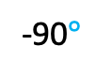
10.2 Average & Reactive Power
+
P = $\frac{1 }{2}V_{m}I_{m}$Cos($θ_{v}$ - $θ_{i}$)
Step 3: Finding average power in passive elements
Resistor: P = + $\frac{1}{2}\left(20∗4\right)∗4$*Cos$0$ = +160 W
Voltage on Capacitor: = -j5 * $I_{2}$= 5 * 10.58
= 52.9
Capacitor: P = + $\frac{1}{2}\left(52.9\right)∗10.58$ * Cos$(−10.9 −79.1°)$
= + 0 Watts
Inductor: P = + 0 Watts
Step 4: Total average power in the circuit
Power absorbed:
207.8 + 160 + 0 + 0
= +367.8 Watts
Power provided:
= - 367.8 Watts
-90$°$
79.1$°$
-10.9$°$

Slide 16
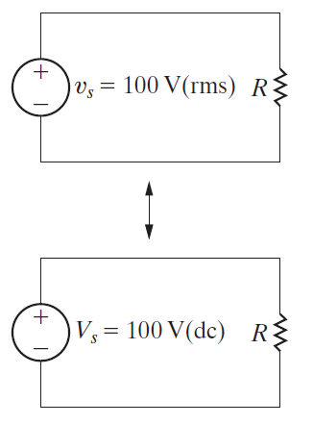
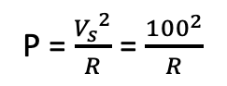
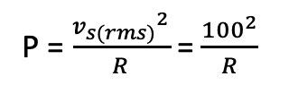
10.3 The rms Value and Power Calculations
The rms or effective value of a periodic ac current (or voltage) is the dc value that delivers the same average power to a resistor as that periodic current (or voltage)
P = $\frac{{v_{s(rms)}}^{2}}{R}$ = $\frac{{100}^{2}}{R}$
P = $\frac{{V_{s}}^{2}}{R}$ = $\frac{{100}^{2}}{R}$

Slide 17
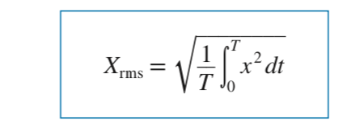



10.3 The rms Value and Power Calculations
For Sinusoidal functions:
(Real) P = $\frac{1 }{2}V_{m}I_{m}$Cos($θ_{v}$ - $θ_{i}$) becomes P = $V_{rms}I_{rms}$Cos($θ_{v}$ - $θ_{i}$)
(Reactive) Q = $\frac{1 }{2}V_{m}I_{m}Sin$($θ_{v}$ - $θ_{i}$) becomes Q = $V_{rms}I_{rms}Sin$($θ_{v}$ - $θ_{i}$)

Slide 18


10.3 The rms Value and Power Calculations Example
Example 9.4 (Page 322)
The waveform is a triangular waveform
Find the rms voltage
${ I}_{rms}$= $\frac{{ I}_{p}}{\sqrt{3}}$

Slide 19

10.3 The rms Value and Power Calculations Problem – rms Value
Problem – Half wave rectified sine wave, find RMS value
The waveform is a half-wave rectified sine wave.
Find the rms voltage, and average power dissipated if this is applied to a 10 ohm resistor

Slide 20

10.3 The rms Value and Power Calculations Example 10.3
Example 10.3
A sinusoidal voltage with a max amplitude of 625 Volts is applied to a 50 ohm resistor. Find average power delivered to the resistor.
Repeat a) by first finding the current in the resistor
For a pure resistor:
P = $\frac{1 }{2}V_{m}I_{m}$ = $V_{rms}I_{rms}$
P = $\frac{{V_{(rms)}}^{2}}{R}$ =${{ I}_{(rms)}}^{2}R$

Slide 21



10.3 The rms Value and Power Calculations
-90$°$
rms
rms

Slide 22




10.3 The rms Value and Power Calculations
-45$°$
rms

Slide 23




10.4 Complex Power
Passive sign convention applies to both the equations above!
If the current reference is in the direction of the ‘voltage rise’ (i.e. if the
current enters from the negative terminal), use the –ve sign

Slide 24

10.4 Complex Power

Slide 25




10.4 Complex Power
$θ°$ is the Power Factor angle, and $θ°$ = $θ_{v}$ - $θ_{i}$
Cos $θ°$ is the Power Factor (pf)
‘Lagging pf’ means current lags voltage (i.e. inductive reactance dominates, pf angle is +ve)
‘Leading pf’ means current leads voltage (i.e. capacitive reactance dominates, pf angle is -ve)
Complex power
Reactive power
Average power

Slide 26


10.4 Complex Power (Formulas using $θ°$)
S = P + jQ
S = |S| $θ°$
S = ${{|I}_{rms}|}^{2} \text{Z}$ and S = $\frac{{{|V}_{rms}|}^{2} }{Z^{∗}}$
P = |S| Cos$θ°$ = $\frac{1 }{2}{I_{m}}^{2}$R = $\frac{{{|V}_{rms}|}^{2} }{R}$ =${{ I}_{(rms)}}^{2}R$
Q = |S| Sin$θ°$ = $\frac{1 }{2}{I_{m}}^{2}X$ = $\frac{{{|V}_{rms}|}^{2} }{X}$
P = $V_{rms}I_{rms}$Cos$θ°$
Q = $V_{rms}I_{rms}Sinθ°$
Complex power
Reactive power
Average power
P (Watts) = S (VA) * Power factor

Slide 27


10.4 Complex Power Example 10.4
Example 10.4
An electrical load operates at 240 Volts (rms). It absorbs an average power of 8kW at a lagging power factor of 0.8 (current lags voltage)
Calculate the complex power of the load
Calculate the impedance of the load, Z
P (Watts) = S (VA) * Power factor
Given, cos $θ$ = 0.8 (lag)
$θ$ = 36.87$°$
sin $θ$= 0.6
S = ${{|I}_{rms}|}^{2} \text{Z}$

Slide 28

10.4 Complex Power Problem – Power Factor
Problem – Power Factor
Calculate the power factor of the entire circuit as seen by the source
Calculate the apparent & average powers delivered by the source

Slide 29


10.4 rms Value and Power Calculations Fun with Reactance!
-45$°$
More Questions:
What is $θ°$ ?
What is the power factor?
What parallel Capacitor, C, can change the pf to 0.9?
What is S from the source?
Derive P & Q at the resistor & inductor using
other formulas (e.g.: P = $V_{rms}I_{rms}$Cos$θ°$)
What is Q if the value of L only is doubled. Pf?
What is P if the value of R only is doubled. Pf?
Replace the reactance with capacitive reactance
of the same (-ve) value, and recalculate everything.
rms

Slide 30



10.5 Power Calculations
Problem 10.5:
In the circuit of Pr 9.60,
$v_{a}$ = 100 Cos50,000t V
$v_{b}$ = 100 Sin50,000t A
Calculate real (average) and reactive power of each circuit element
Verify that the average power generated equals the power absorbed
Verify that the magnetizing vars generated equal the magnetizing vars absorbed
The currents from Pr 9.60 solution were:
$I_{a}$ = 0 - j10 A
$I_{b}$ = -20 + j10 A
and so
$I_{o}$ = 20 – j20 A

Slide 31


10.5 Power Calculations
Example 10.6 Calculating Average & Reactive Power
Calculate phasors $V_{L} \& I_{L}$
Calculate the reactive & average powers delivered to the load
Calculate the reactive & average powers delivered to the line
Calculate the reactive & average powers supplied by the source

Slide 32


10.5 Power Calculations
Problem 10.21 Calculating Average & Reactive Power
Load 1: absorbs 60kW, delivers 70 kVAR
Load 2: has an impedance of 24 + j7 ohms
$V_{L}$= 2500$\sqrt{2}$Cos 120$πt Volts$
Find the rms value of the source voltage
By how many microseconds is the load voltage out of phase with the source voltage
Does the load voltage lead or lag the source voltage?

Slide 33


10.5 Power Calculations – Power factor
The ideal power factor is unity, or one (1.0) which means that all the energy supplied by the source is consumed by the load.
Anything less than pf = 1.0 is wasteful
pf close to 1 is desirable
Low power factor may cause power losses and voltage drops, which can contribute to overheating and failure of motors and other equipment.
Electricity supply company charges penalty for lower pf

Slide 34





10.5 Power Calculations – Power factor correction
Industrial loads generally include lots of large kW motors. These draw high Inductive VARs (+$Q_{L}$)
Hence, pf is always lower than 1.0
To improve the situation,
add Capacitors, which work as reactive power ‘generators’, providing capacitive VARs (-$Q_{C}$)
The expense of adding capacitors reduces the ongoing cost of poor pf (for which the industry has to pay the electricity supply company)
Say, $∅_{1}$= 45$°$, Cos $∅_{1}$= 0.70
$∅_{2}$= 30$°$, Cos $∅_{2}$= 0.86
$−Q_{C}$Supplied
by
capacitor

Slide 35





10.5 Power Calculations – Power Factor(pf) Correction using Additional Capacitance
Example 10.7 Parallel Loads, pf Correction
$L_{1}$ absorbs 8kW at 0.8 pf lead, $L_{2}$ absorbs 20kVA at 0.6 pf lag
Calculate the power factor of the two loads in parallel
Determine the apparent power required to supply the loads, the magnitude of the current $I_{S}$ and the average power loss in the transmission line
Given the frequency of the source is 60 Hz, compute the value of the capacitor (C) that would correct the power factor to 1 if placed in parallel with the two loads. Recalculate the values in b) with the corrected power factor.
C
Load 1:
Given, cos $θ$ = 0.8 (lead)
$θ$ = - 36.87$°$
sin $θ$= - 0.6
P = 8kW at 0.8 pf lead
|S| = 8000/0.8 = 10000
Q = |S|*Sin $θ$ = -6000

Slide 36
10.5 Power Calculations – Power Factor(pf) Correction using Additional Capacitance
Problem 10.31 pf Correction
A group of small appliances on a 60 Hz system requires 20kVA at 0.85 lagging when operated at 125V (rms).
The impedance of the feeder supplying the load is 0.01 + j0.08 ohms.
The voltage at the load end of the feeder is 125V (rms).
What is the rms magnitude of the voltage at the source end of the feeder?
What is the average power loss in the feeder?
What value of the capacitor (C) would correct the power factor to 1?
After the capacitor is installed, what is the rms magnitude of the voltage at the source end of the feeder if the load voltage is maintained at 125 V(rms)?
What is the average power loss in the feeder for d) above?

Slide 37





10.6 Maximum Power Transfer

Slide 38




10.6 Maximum Power Transfer
Example 10.9
Calculate the impedance $Z_{L}$ that results in maximum average power transferred to $Z_{L}$
What is the maximum average power transferred to the load impedance found above?

Slide 39


10.6 Maximum Power Transfer
Problem 10.44
What is the maximum average power transferred to $Z_{L}$ ?
What percentage of the total power developed is transferred to the load impedance found above?

